Slide 1
“Clean Fuels for All”
The strategy of the refining industry for the decarbonisation of transport d
..
Pau, May 2022

Slide 2








































FuelsEurope represents 40 Member Companies ≈ 95% of EU Refining

Slide 3
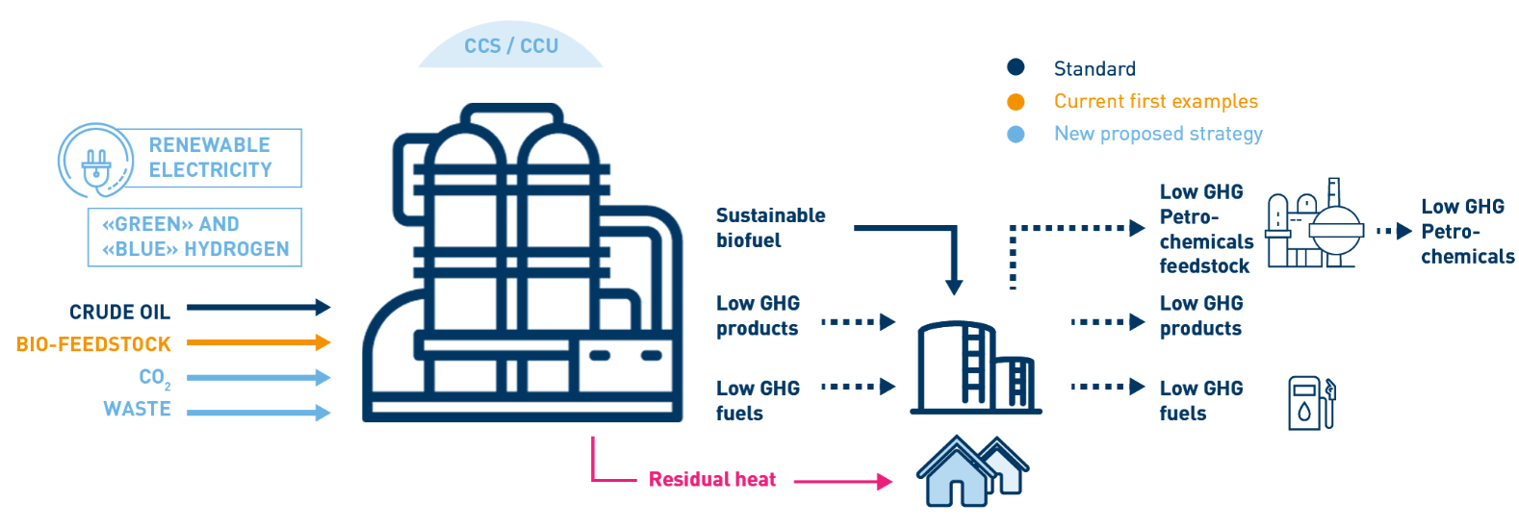
The future refinery: an ENERGY HUB…
… within an INDUSTRIAL CLUSTER
Page 3

Slide 4



What is Clean Fuels for All about?
The EU refining industry’s potential pathway to achieve climate neutrality by 2050 in all transport modes.
By 2050, at the latest, every litre of liquid fuel for transport could be net climate neutral, enabling so the decarbonisation of aviation, maritime and road transport.
Up to 650 bln€ investment over 30 years.
What are“Low-Carbon Liquid Fuels” ?
Renewable and sustainable liquid fuels from non-petroleum origin.
Produced from new feedstock such as biomass, renewable energy, waste and
recycled CO₂.

Slide 5
Clean Fuels for All in numbers
Page 5

Slide 6
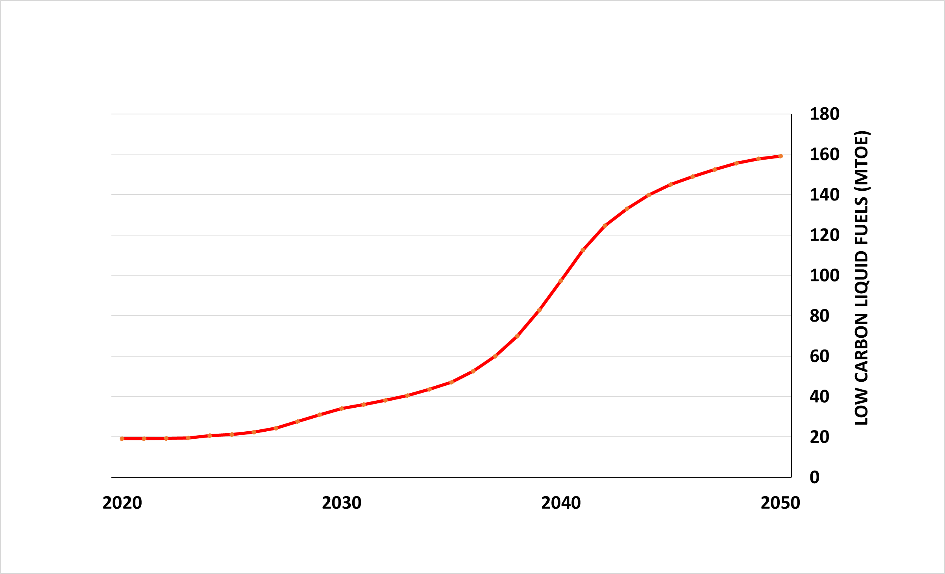
Low-Carbon Liquid Fuels progressively replacing fossil fuels in transport
Total liquid fuels (fossil + LCLF)
350
300
TOTAL LIQUID FUELS IN TRANSPORT (MTOE)
84%
40%
10%
5%
Total LCLF
FuelsEurope’s elaboration, based on Concawe’s scenario assuming LCLF in all transport modes.
Page 6

Slide 7
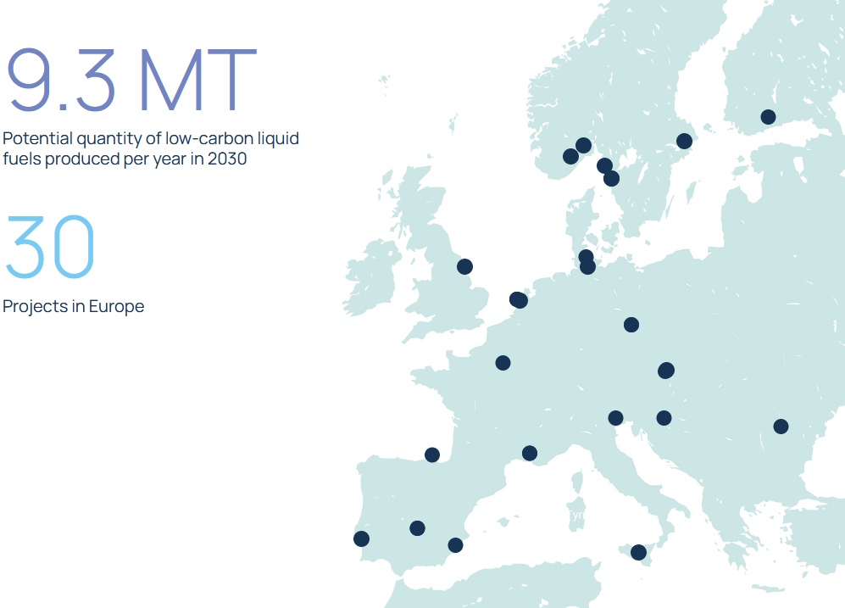
Transition to low-carbon liquid fuels initiatives
FuelsEurope’s members pursue a wide range of low-carbon initiatives across at least 12 Member States in different phases of the project cycle, including CCUS, E-Fuels, Green H2, Advanced biofuels, bio-refinery conversions, waste to fuel, etc.
  Well over 20 projects for low-carbon liquids have already been started or are planned until 2030 (in the public domain).
  Projects facilitate industrial clustering though links with Chemicals, Recycling, Steel and Cement Industries, …
  Scaling up & increasing the overall number of projects will be possible with the right enabling framework in place.
Provisional examples*:
20 Advanced biofuel projects, with capacities between 100.000 and 750.000 tonnes of output.
12 CCUS projects, up to 6 mt. of capacity for CO2 sequestration.
5 Green Hydrogen Projects, some of which lower the GHG intensity of manufacturing processes, others combine the green H2 with captured carbon to produce synthetic fuels with a capacity of up to 3.4 million tonnes of output per year.
3 Waste-to-fuel projects, with a capacity of up to 100.000 tonnes per year in output (derived from urban waste).
**
  See more:
  https://www.cleanfuelsforall.eu/towards-climate-neutrality/
  https://www.concawe.eu/low-carbon-pathways/
*While the final list of projects may differ from the map or the list shown here, these projects are being considered by FuelsEurope’s members to be put forth for support under the EU Recovery Fund.
**9.3 MT figure based on publicly available data, but the actual number is expected to be +/- 10MT for potential quantity of low-carbon liquid fuels produced per year in 2030.
Page 7

Slide 8
The policy debate on the Fit for 55 Package
RED
ETS
Fuels Infrastructures
CBAM
(Politically driven) technology mandates
Weakening carbon leakage protection
(Politically driven) exclusion of some alternative fuels
Lack of assessment of impact on citizens and business
CO2 emissions standards LDV
Energy Efficiency
Energy Taxation
Aviation Fuels
Maritime Fuels

Slide 9
www.cleanfuelsforall.eu
Thank you

Slide 10
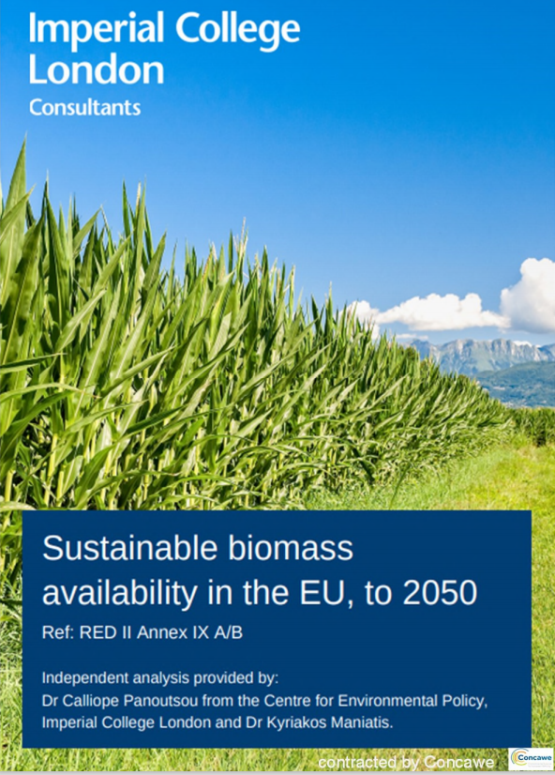

2. Study on Sustainable Biomass Availability in the EU, to 2050
Is the production of advanced biofuels in line with the current RED sust. criteria?
F.A.Q. On advanced biofuels and sustainable feedstocks
Can the EU rely on the sustainable biomass for transport purposes?
Would that be in competition with electricity production and bioproducts?
Would the sustainable biomass be available in 2030 and 2050?
Published on 24/8/2021
Advanced and waste-based biofuels are dismissed by some for an alleged scarcity of sustainable biomass feedstock of agricultural, forest and waste origin, or a possible harm to biodiversity.
Sustainable biomass availability in the EU, to 2050 – FuelsEurope

Slide 11
Enough sustainable biomass available for road, aviation and marine fuels biofuels
Enough biomass available to support 70 to 175 Mtoe biofuels
Enough biomass available to support 50 to 100 Mtoe biofuels
Total LCLF, of which advanced and waste-based biofuels
FuelsEurope’s elaboration, based on the Imperial College London Cons. study and Concawe’s scenario assuming LCLF in all transport modes.
https://www.concawe.eu/publication/sustainable-biomass-availability-in-the-eu-to-2050/
Page 11

