Slide 1
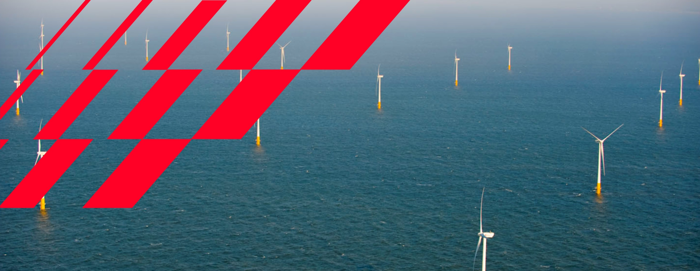




Challenges and solutions for increased RES integration
Multiterminal Experiences
02-11-2023

Slide 2
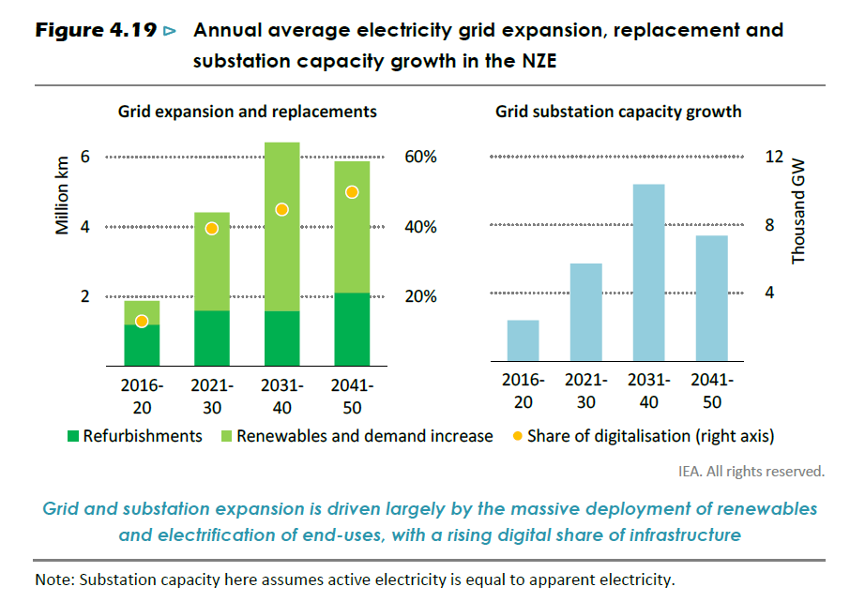

Power grid infrastructure required for net zero roadmap

Slide 3
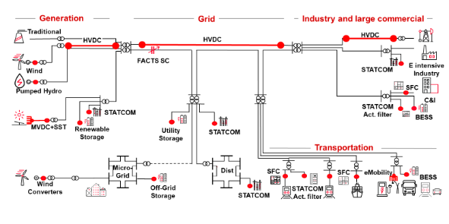
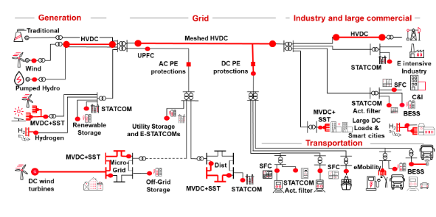
Power electronics enabling carbon-neutral energy landscape
The grid today…
The future grid in 15 years…
Less carbon¹ > More renewables > More variability > More power quality need > More power electronics devices

Slide 4


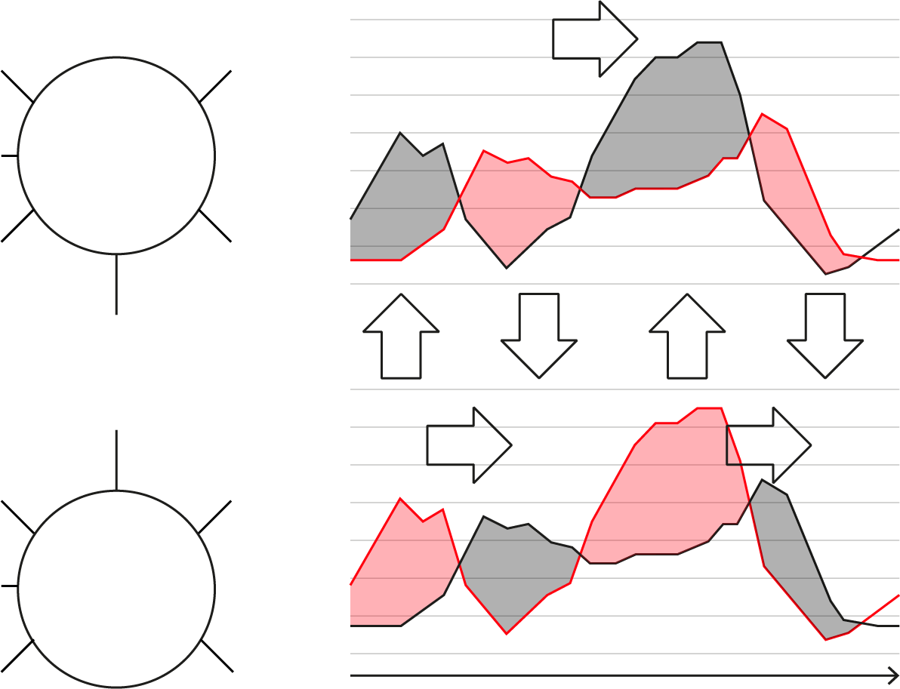
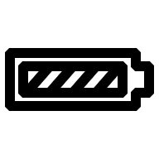
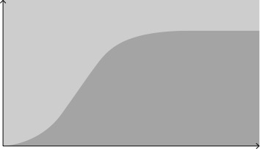

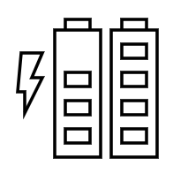

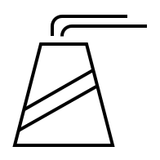
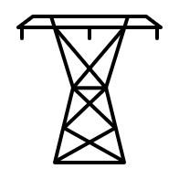
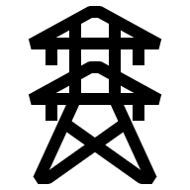
There is a need for hybrid solutions – DC transmission & Storage
Both are essential to meet demand in a world of renewables
Storage within a region vs. Interconnecting two regions
Optimal Mix – Fraction of Storage vs. Interconnection
Ideal mix fraction
Power
Storage is preferred
Power
Interconnection is preferred
Time
Spatial Price Difference between supply and demand
Notes:
Storage allows for a time shift between generation and demand within a region
Transmission allows for a spatial shift between generation and demand between regions
As generation becomes more volatile with the integration of more renewables, both solutions are needed

Slide 5
Offshore wind connections
Offshore wind: average distance from shore by country
80
Increasing project sizes at sites farther out at sea and away from the grid connection point have a significant impact of the offshore transmission design
60
40
20
United
Kingdom
Germany
Netherlands
Denmark
United
States
China
Commissioned
Under construction and pipeline

Slide 6
Offshore wind connections
Indicative cost for HV transmission systems by type and distance from shore
With increased distances from shore, offshore wind farm developers will benefit from using HVDC as their grid connection solution
System CAPEX incl cable
10-50
50-100
100-150
150-200
Km
AC
DC

Slide 7
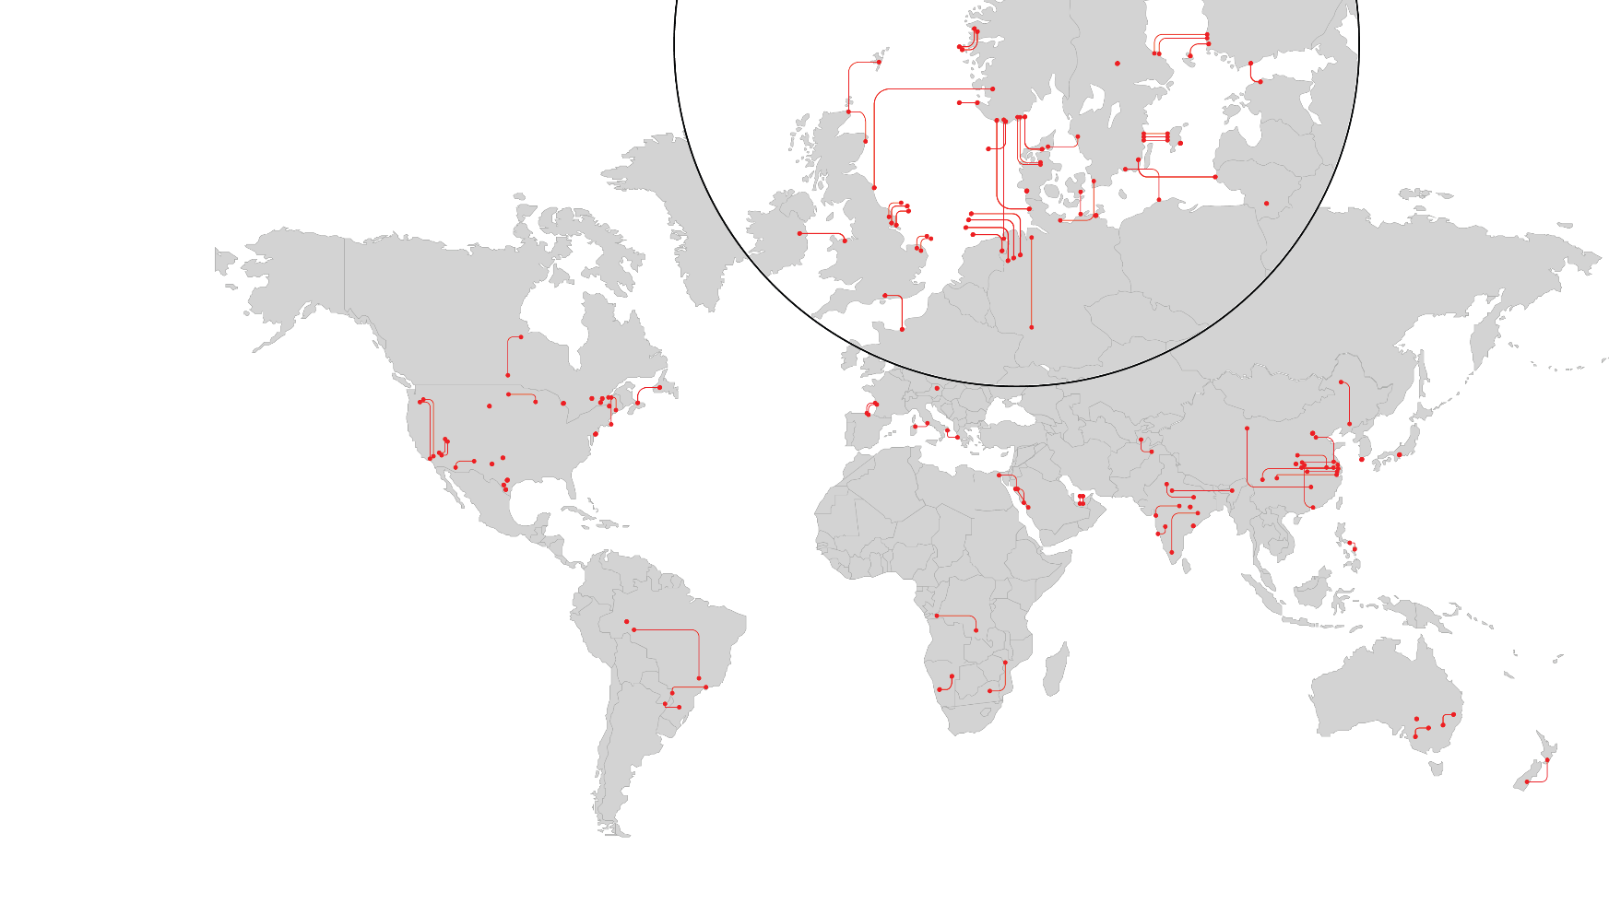
HVDC becoming mainstream in all corners of the world
Interconnecting Grids
Heavyweight market
~300 GW
Operating world
Installed base
~3x
Growth rate
vs. world GDP
>50%
World installed base equipped with
Hitachi Energy
Our installed base

Slide 8
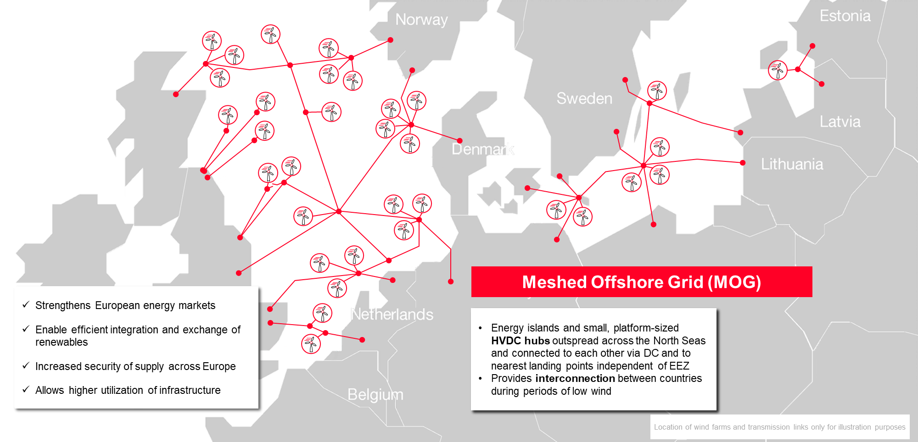
Meshed Offshore Grid – Driver / Needs
Offshore wind grid connection systems using HVDC technology are nowadays planned and executed in point-to-point connections. Hitachi Energy performed a future scenario modelling, indicating the need for Offshore wind expansions, where the European case is urging on so called Meshed Offshore Grids (MOG).

Slide 9
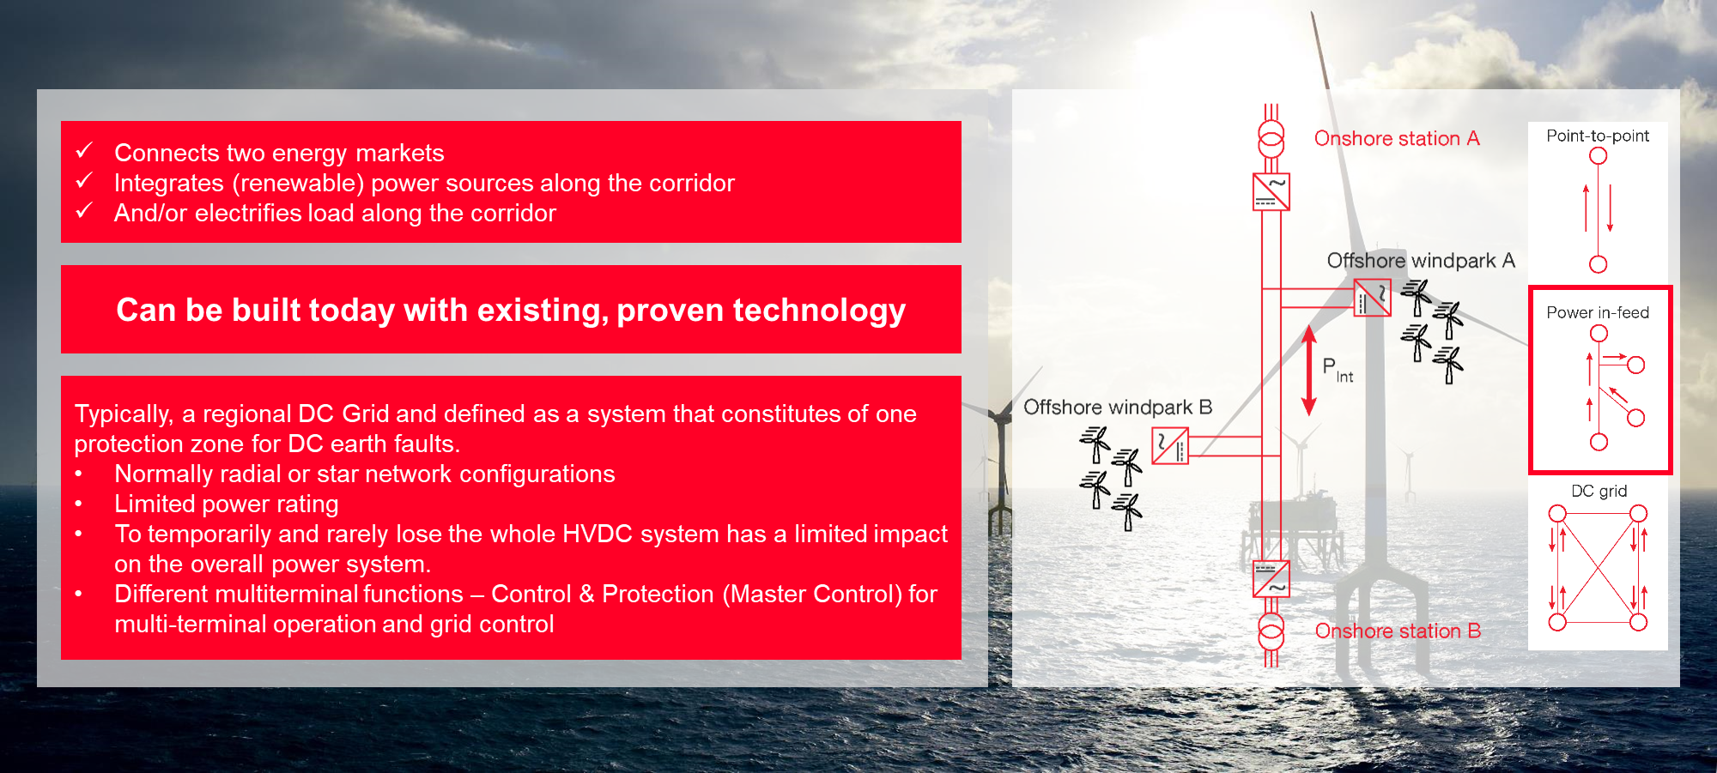
Field-experiences with well defined standards
Hitachi Energy has in the years grown extensive engineering competences to support the development, the design and the execution of multiterminal HVDC systems in a single vendor environment and has contributed to several trade associations and working groups. This process started already in a number of working groups in CIGRE around 2010 and is still ongoing.

Slide 10
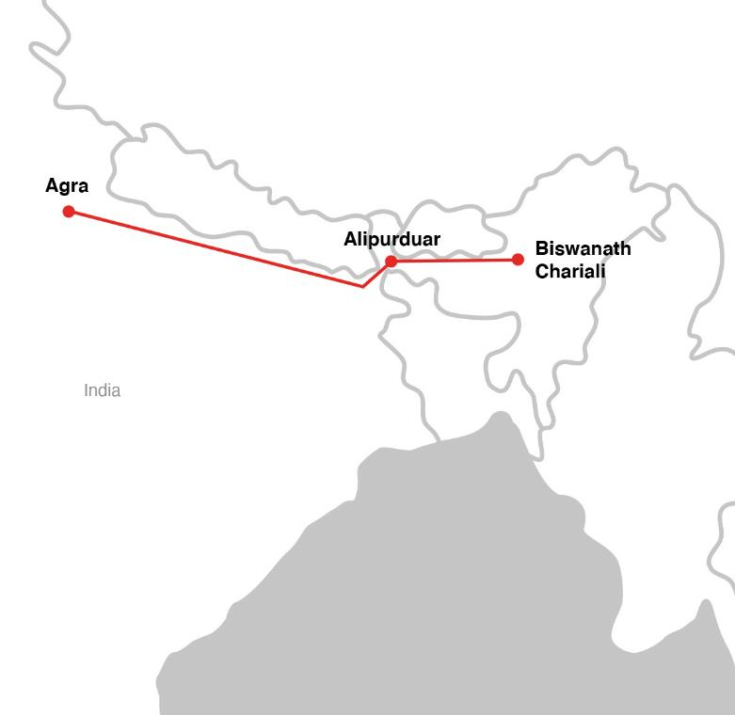

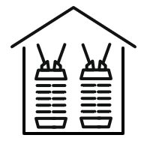
North-East Agra
Customer
Powergrid Corporation in India Ltd
Customer needs
Transmission of 6000 MW hydropower from the north-eastern parts of India to the region of Agra – over 1700 km
Our response
Turnkey 6000 MW ±800 kV UHVDC system
Multiterminal – three converter stations
Customer benefits
Low losses – 6 %
8000 MW converter capacity, providing redundancy for loss of one converter with retained transfer capacity
Year
  2014 - 2016
HVDC Classic
converter stations
  Multi-terminal UHVDC transmission link
      6,000 MW in power capacity
The world’s first multi-terminal UHVDC transmission link, enabling the transmission of a clean power supply for 90 million people

Slide 11
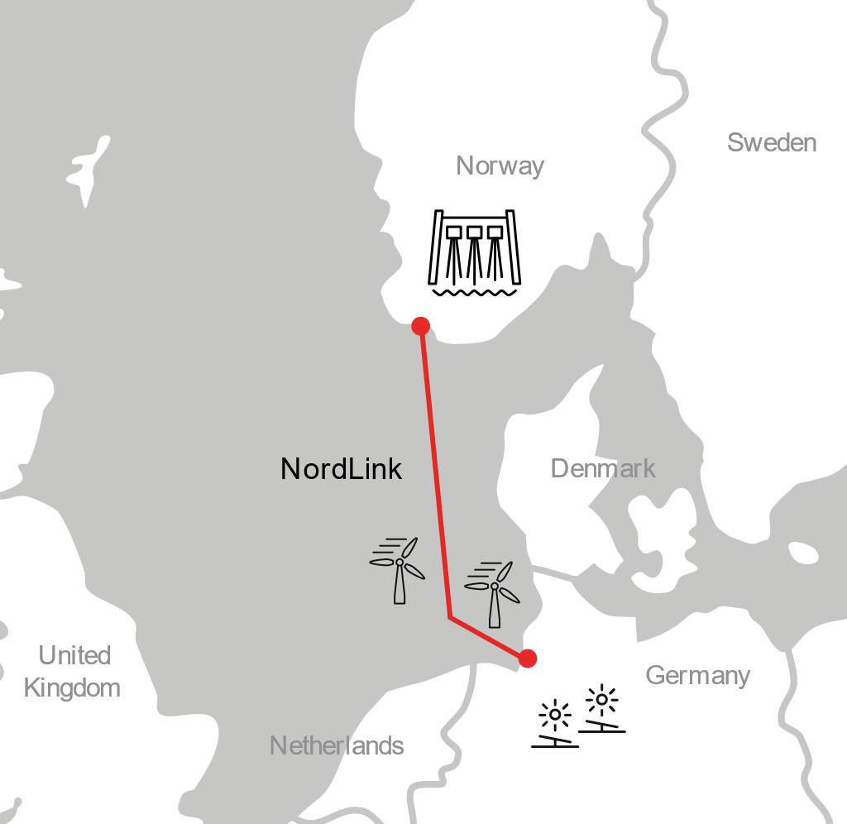
NordLink
Customer
Statnett/TenneT, Norway and Germany
Customer needs
  Meet EU’s target for CO₂ reduction
  Security of supply
Our response
  Two 1,400 MW, ±525 kV HVDC Light® converter stations
  525 kV DC subsea and land MI cables for over 200 km of the route
Customer benefits
  To meet fluctuations in power demand by using the other country’s renewable surplus power
  Higher availability
Year
  2020
HVDC Light®
converter stations
  Bipolar ±525 kVdc
  Ertsmyra: 400 kV
  Wilster: 380 kV
Land and sea DC
cable system
The stable, large-scale integration and exchange of renewable power in the European Union

Slide 12
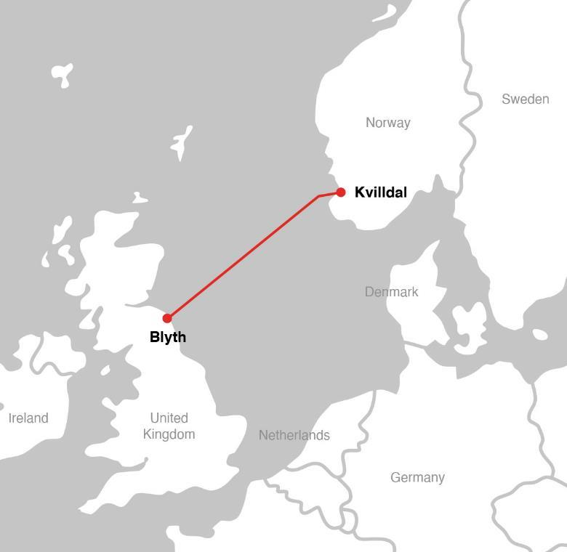
NSL
Customer
Statnett SF in Norway and National Grid in United Kingdom
Customer needs
  Security of supply
  Meet EU´s target for CO₂ reduction
  Energy trade
Our response
  Two 1,400 MW, ±515 kV HVDC Light® converter stations
Customer benefits
  Security of supply
  Fluctuations in power demand to be met by using the other country’s renewable surplus power
Year
  2021
HVDC Light®
converter stations
  Bipolar ±515 kVdc
  Kvilldal: 420 kV
  Blyth: 400 kV
Land and sea DC
cable system
Increased security of power supply and social-economic benefits for both countries

Slide 13
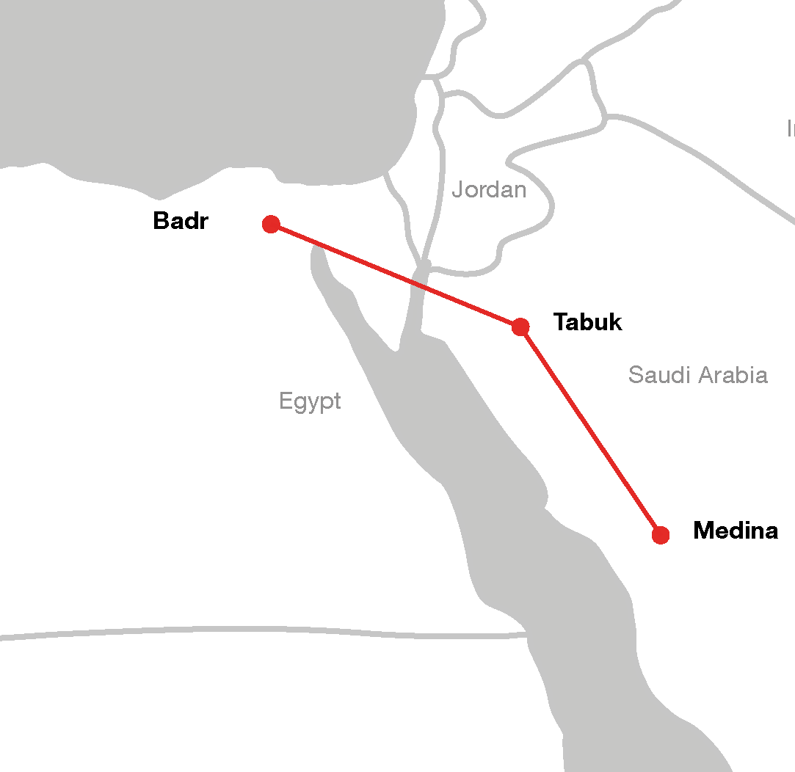
Saudi Arabia - Egypt
Customer
  Saudi Electricity Company (SEC), Saudi Arabia and Egyptian Electricity Transmission Company (EETC), Egypt
Customer needs
Power transmission and energy trading between countries
Our response
3,000 MW ±500 kV multi-terminal solution with power flow in multiple directions
Three turnkey HVDC converter stations: Medina, Tabuk and Badr
Customer benefits
Facilitate electricity trade between Saudi Arabia and Egypt
Connecting the two grids with strengthening grid resilience
Power supply security and optimization of energy production
Year
  2025
HVDC Classic
converter stations
  Multi-terminal solution
      Medina: 3,000 MW; Tabuk 1,500 MW; Badr 3,000 MW
The first ever large-scale HVDC interconnection in the Middle East and North Africa

Slide 14
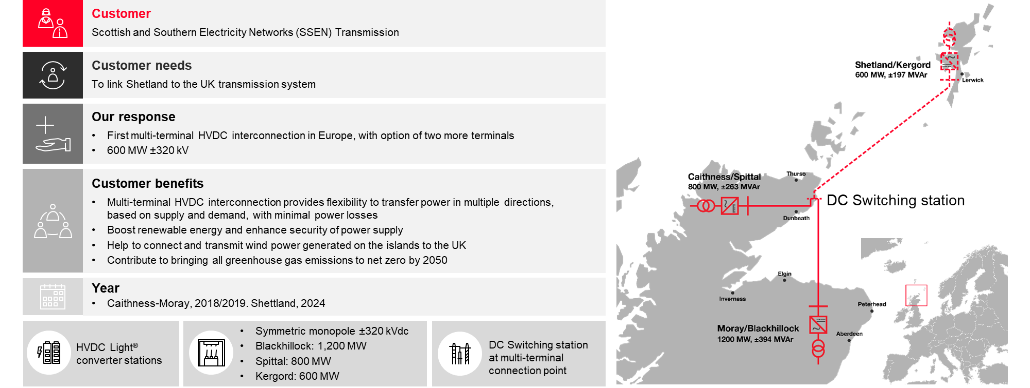
Learning from Caithness-Moray project
Hitachi Energy’s portfolio for developing DC-hubs and multiterminal systems includes state of the art VSC converters in different configurations, engineering solutions as for CMS HVDC link reference, but also looks back to references such as: Quebec-New England, North-East Agra, Saudi-Egypt, Zhangbei & NordBalt.

Slide 15

Caithness Moray Shetland HVDC Link - VIDEO

