Slide 1
SURVEY RESULTS
ON GREEN TRAINING NEEDS
OF THE EUROPEAN SMEs

Slide 2
SIZE OF THE SAMPLE
Total of 1108 valid questionnaires filled in, distributed as follows:
COUNTRY | QUESTIONNAIRES
BULGARIA | 206
ESPAÑA | 117
GERMANY | 1
GREECE | 272
HUNGARY | 1
ITALY | 200
ROMANIA | 201
TURKEY | 110
TOTAL | 1108

Slide 3
Size of the SMES involved

Slide 4
SECTOR | NUMBER
Manufacturing | 284
Wholesale and retail trade; repair of motor vehicles, motorcycles and personal and household goods | 213
Hotels and restaurants | 109
Construction | 98
Other community, social and personal service activities | 72
Electricity, gas and water supply | 63
Other | 56
Agriculture, hunting and forestry | 47
Real estate, renting and business activities | 34
Transport, storage and communication | 30
Health and social work | 22
Private households with employed persons | 17
Financial intermediation | 14
Education | 13
Mining and quarrying SubSection CA : Mining and quarrying of energy producing materials | 5
Public administration and defence; compulsory social security | 5
Fishing | 2
Economic sector of Participating SMES

Slide 5
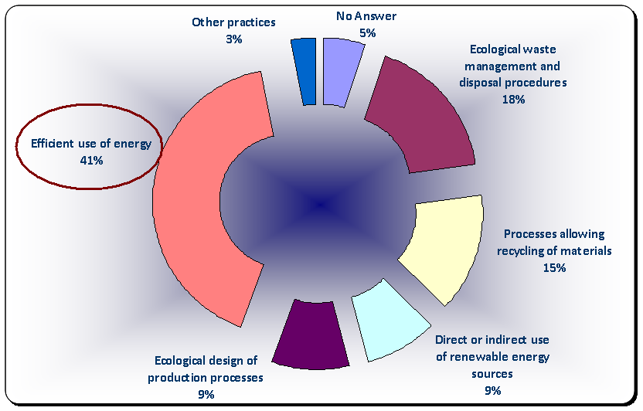
Green practices currently implemented in SMEs

Slide 6
Reasons for SMEs to implement green practices: Savings and Image

Slide 7
Major DRAWBACKS on the introduction of environmentally friendly practices in SMEs

Slide 8
Benefits expected to achieve by implementing green policies

Slide 9
Adoption of quality standards
EN ISO 14001 is
the most adopted
reaching 67%
of those 19%
adopting quality standards

Slide 10
Countries adopting quality standards

Slide 11
Position of the SMEs regarding training
61% have regular or occasional implementation of training courses, while 25% assured the implementation of training courses is “rare”.

Slide 12
Follow of ICT Courses
From those 30% who have followed ICT related training courses 72% declare to have followed blended learning courses (including face to face sessions and online learning)

Slide 13
The use of the Internet for learning is rare !

Slide 14
Preferred features in online courses
The respondents rated over 4 -very important-:
the Quality of learning contents
Loading time
Text easy to read and use
and Usefulness of certification

Slide 15
Interest of SME workers to follow training courses
48% said “maybe” and 31% “would love to”

