Slide 1
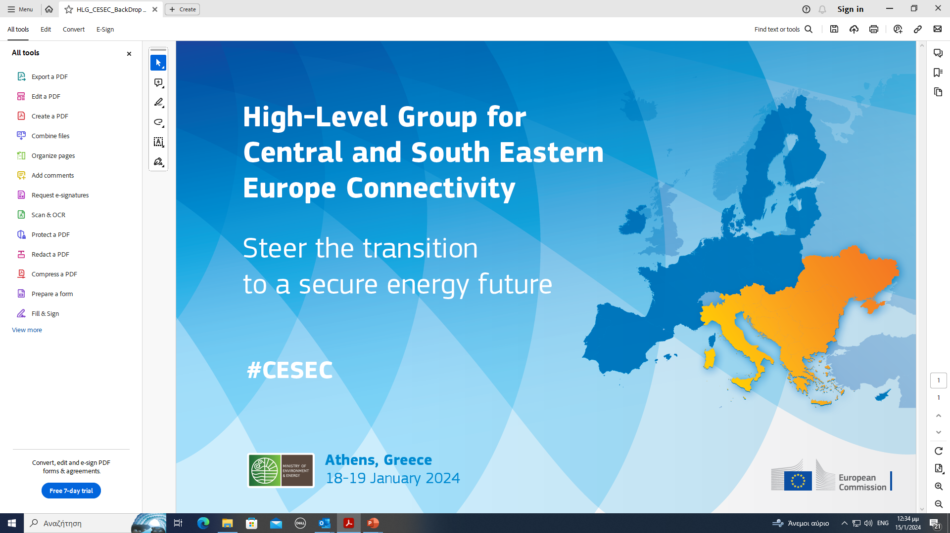

Slide 2


THE CESEC
INITIATIVE
MINISTERIAL
MEETING

Slide 3
About CESEC
THE CESEC INITIATIVE
MINISTERIAL MEETING
ATHENS 18-19 JAN
Central and South Eastern Europe Energy Connectivity
The CESEC works to accelerate the integration of gas and electricity markets in the region.
The CESEC high-level working group was set up by Austria, Bulgaria, Croatia, Greece, Hungary, Italy, Romania, Slovakia and Slovenia and the EU in February 2015.
Slovakia is no longer a member of CESEC since 2021.
They were joined later by eight Energy Community (organisation bringing EU and its neighbours together to create an integrated pan-European energy market) contracting parties: Ukraine, the Republic of Moldova, Serbia, the Republic of North Macedonia, Albania, Bosnia and Herzegovina, Kosovo (in line with UNSCR 1244 and the ICJ Opinion on the Kosovo declaration of independence) and Montenegro.
In 2017 members signed a MOU, CESEC - Memorandum of Understanding (updated September 2017) - European Commission (europa.eu)
2023: 16 members
Web: Central and South Eastern Europe energy connectivity (europa.eu)
2

Slide 4
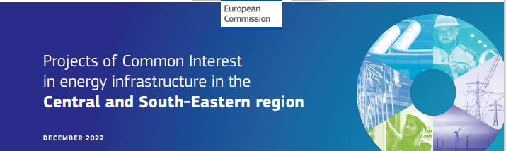

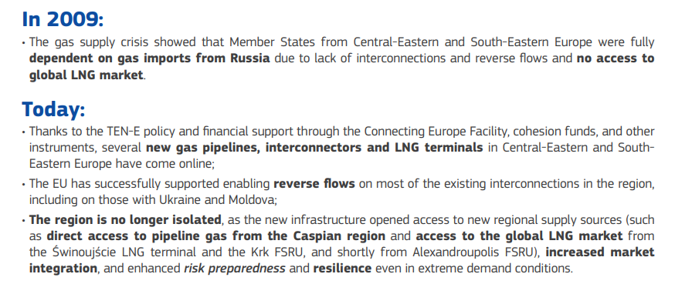
About CESEC
Dec. 2022
THE CESEC INITIATIVE
MINISTERIAL MEETING
ATHENS 18-19 JAN
3

Slide 5
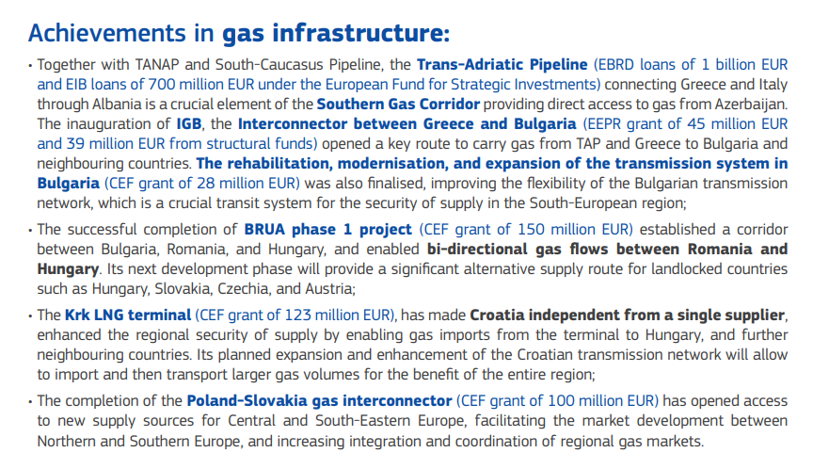
About CESEC
Dec. 2022
THE CESEC INITIATIVE
MINISTERIAL MEETING
ATHENS 18-19 JAN
4

Slide 6
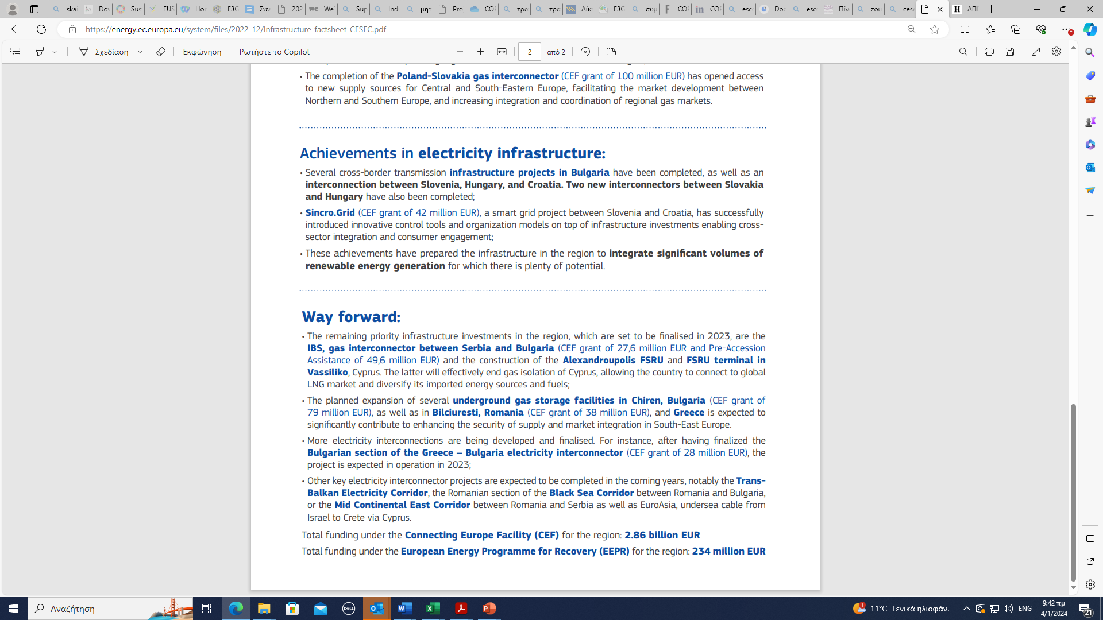
About CESEC
Dec. 2022
THE CESEC INITIATIVE
MINISTERIAL MEETING
ATHENS 18-19 JAN
5

Slide 7
MINISTERIAL MEETING OF THE CESEC INITIATIVE
ATHENS 18 - 19 JANUARY 2024
THE CESEC INITIATIVE
MINISTERIAL MEETING
ATHENS 18-19 JAN
MEETING SCHEDULE
Thursday 18, January 2024
18:00' - 19:00' Acropolis Museum Guide Tour
19:00' - 21:00' Official Dinner – Acropolis Museum
Friday 19, January 2024
08:30' - 14:30' Ministerial Meeting, GRAND HYATT HOTEL
14:30’ – 14.45’ Joint press statement by Commissioner Kadri Simson and Minister
Theodoros Skylakakis
7

