Slide 1




Ministry of Environment, Energy and Climate Change of the Hellenic Republic
Project Helios
The Greek Solar Energy Project
Hamburg, 5th September 2011
1

Slide 2
Why Helios
The context
The market
The opportunity
The framework
The project
The benefits
2

Slide 3
The context: Statement by the Heads of State or Government of the Euro area & EU institutions
Brussels, 21 July 2011
“We call for a comprehensive strategy for growth and investment in Greece… to target the structural funds on competitiveness and growth, job creation and training. We will mobilize EU funds and institutions such as the EIB towards this goal and re-launch the Greek economy.”
3

Slide 4
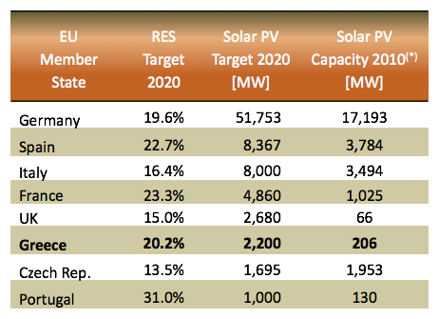
The market: EU Solar Sector
EU accounts for 74% of global market
2010-EU: 13,300 MW new installations vs. 100 MW in 2001
Germany: global market leader in Solar PV
Smart incentive schemes (Feed-in Tariffs)
“20-20-20” RES Policy : Binding Directive 2009/28/EC, National Renewable Energy Action Plans
4

Slide 5
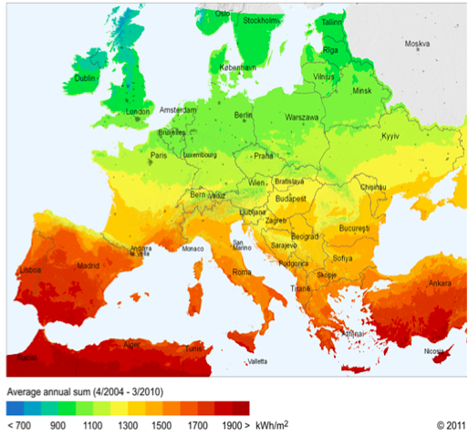
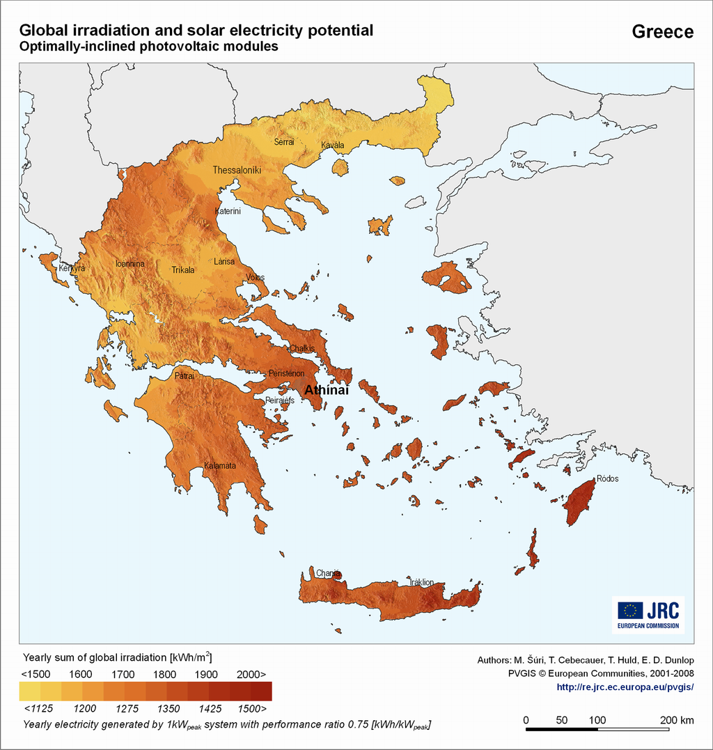
The opportunity: “Helios” - The power of the sun
Greece enjoys 300 days of sunshine a year and almost 50% more sun radiation than Germany, the global leader in solar PV
European Sun Radiation Levels

Slide 6
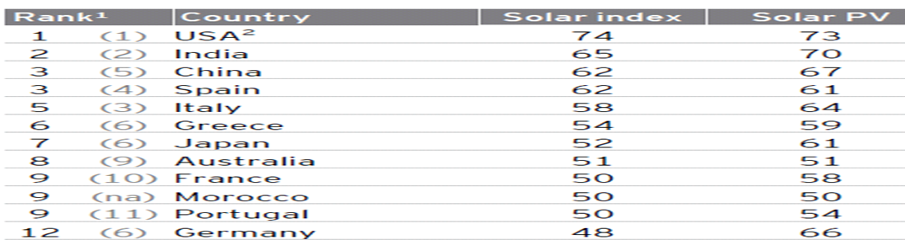
Why Greece?
Producing where the resources are!
Solar intensity means potential is far greater than present targets for 2020
Can be tapped to the benefit not only of Greece, but of other EU countries as well (average annual sun Irradiation for Greece 1800 KWh/m², vis-à-vis 1285 KWh/m² for Germany)
According to the Ernst & Young “Renewable energy country attractiveness indices” report, Greece is in 6th place among 35 countries, regarding the solar index (takes into account power off take attractiveness, tax climate, market growth potential, installed base, recourse quality and project size)

Slide 7
The RES framework in Greece
National target for RES: 20% on final energy consumption, 2% above the mandatory 18% set by 2009/28/EC
Specific targets for RES electricity (40%), RES heating and cooling (20%) and RES transport share (10%)
Targeted capacity for solar PV by 2020 = 2200 MW, 10 GW of PV for the year 2050
For the first half of 2011 total installed capacity was 274 MW and it is estimated to reach 400 MW by end-year
Plan foresees Interconnection of mainland Electricity Transmission Grid with the islands
reserve and storage units (2 GW of pumped storage plants by 2020 and 4 GW of pumped storage plants by 2050)
Simplification of licensing procedures and designation of shorter issuing deadlines

Slide 8
“Helios” – the Greek Solar Energy Project
Exporting clean energy from the south to the north of Europe
The “Helios” project aims to render Greece the “showcase” of Solar PV development in Europe’s Sunbelt and the main driver of the country’s green economic growth by:
  monetizing an abundant natural resource (solar energy)
  creating favorable conditions for sustainable development in the solar energy sector
  facilitating other Member States in achieving their 2020 RES targets by offering more attractive investment returns for solar PV projects (higher yields for the same cost of investment)

Slide 9
“Helios”- Project Scope
The target: to produce 3 to 10 GW of solar generated electricity
(At an average investment cost of 2m€/MW the investment for 10 GW is approximately 20 billion Euros)
The method: Develop a cooperation mechanism with other EU Member States under the European Renewable Energy Directive :
Statistical transfer (Article 6)
Joint projects (Article 7)
Joint support schemes (Article 11)
Project “Helios” presents a mutually beneficial cooperation scheme. A member state with low or expensive RES potential (the “receiving” state) can use renewable electricity produced in another country with higher RES potential and lower production costs (the ”exporting” state) to comply with their national target, achieve significant cost savings and facilitate the achievement of the overall European target for 2020.

Slide 10
“Helios”-Project Framework
Under the cooperation mechanism, the Hellenic Republic will provide an “all-inclusive” platform to encourage and facilitate investments in the solar sector, by presenting potential investors with ”turn key” – fully licensed project SPVs in specific state-owned site locations, free of any administrative and bureaucratic barriers. This entails:
  Appropriately selected State-owned land parcels across Greece. Achieving a target of 10 GW in solar generated electricity requires approximately 200 Km² of land. The parcels will be “leased” out for a specific time period (e.g.25 years)
  Fully licensed “trouble free” projects with final stage operating permits
  Relevant connection agreements with the National Grid

Slide 11
… is physical transfer an option?
Grid development in the ENTSO-E (European Network of Transmission System Operators for Electricity) is a prerequisite to ensure electricity market liberalization and large-scale penetration of RES.
EU Communication regarding energy infrastructure priorities for 2020 and beyond gives an October 2011 deadline for proposal submissions to develop a blueprint for an integrated European energy network.
Transmission of 2-2.5 GW generated from PVs I Greece towards central Europe is currently technically feasible with potential congestion point the border of Italy-Slovenia-Hungary
Reinforcing the interconnections between Greece and other EU countries and the development of interconnections within Greece (mainland and Greek islands) will be necessary.
South to north transmission will require trans-border transmission rights in all intermediate borders. Under the existing framework rights are granted through auctioning on a yearly, monthly or daily basis.

Slide 12
Benefits of “Helios”
  For the investors: Extremely attractive from an investment point of view as for the same cost of investment the higher insolation generates significantly higher returns on investment
  For Greece: Involves significant inward FDI, employment creation, tax receipts, building up RES capacity, a potential large privatization project, improves growth prospects
  For Germany and other MS : Generates significant cost savings by using RES produced in a country with higher RES potential and lower production costs, assists in meeting the targets set by RES Directive.
  For Europe: Catalyst to promote interconnection strategy, promotes EU technology & equipment, fits in perfectly with the European growth strategy
  The Helios project is a feasible mid-term project, while others such as the Mediterranean Solar Plan remain a long term vision, facing important technological, economic and political challenges

Slide 13
Thank you for your attention
http://www.ypeka.gr
13

